Slide 1
Kickin’ It with Coleman and David
KickShot Android app
November 30, 2012

Slide 2
We will talk about
KickShot game. What is it?
Choosing our platform
Research of the platform language (Java or Objective-C)
Development Milestones
Future hopes for project
Demo

Slide 3
What is KickShot?
KickShot is a board game created by Aziz Makhani
Sports Cards & Games
Engage
Entertain
Educate

Slide 4
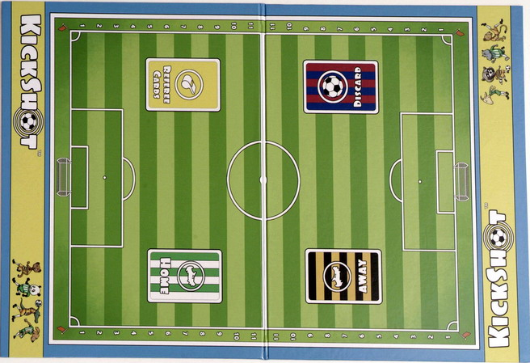
How is KickShot played?
Turned base game that utilizes decks of cards, dice, and a ball token.
Score Zone

Slide 5
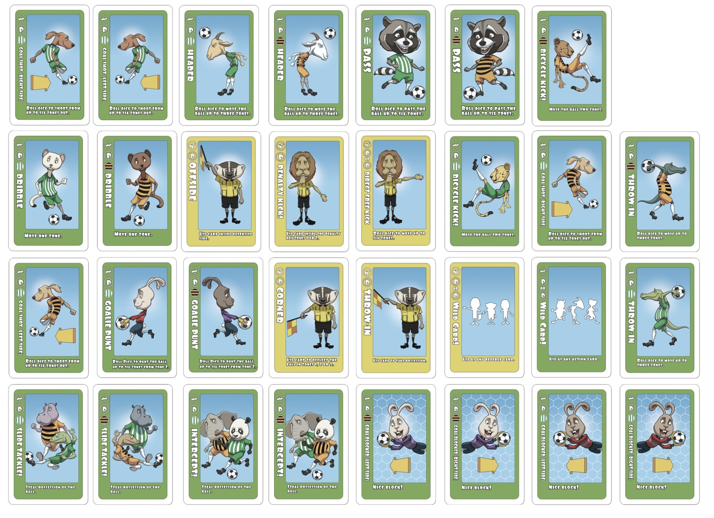
13 Action and 6 Ref cards round out the card deck

Slide 6

Choosing Platform
Lack of access to IOS development environments

Slide 7

Choosing Platform
Android app language (Java) much like other popular languages.

Slide 8

Choosing Platform
Rising app market of Android

Slide 9
Research for Android app
Learn Java
Download Android SDK

Slide 10
Original Development Plan
Program game logic first, then add graphics
Use constant updating game loop thread
Card selection be selected from icon menu

Slide 11
Development Cycle
Get a board image to appear
Blitting card art
Card selection gallery
Logic started
Soccer ball
Logic integrated with board
Added second player

Slide 12
Future of KickShot
//@Todo
Game modes
Shot on goal
Referee cards
Overtime shootout mode
More card logic
Score board
Improve UI/UX

Slide 13
Now for a Demo…

Slide 14
Questions or Comments?

